Slide 1




TELE-CONSULTATION APP
Topic:-Diabetes Prediction based on certain diagnostic measurements
Presented By:-
Souvik Karmakar

Slide 2

Abstract:-
Diabetes is an illness caused because of high glucose level in a human body. Diabetes should not be ignored if it is untreated then Diabetes may cause some major issues in a person like: heart related problems, kidney problem, blood pressure, eye damage and it can also affects other organs of human body. Diabetes can be controlled if it is predicted earlier. To achieve this goal this project work we can do early prediction of Diabetes in a human body or a patient for a higher accuracy through applying, Various Machine Learning Techniques. Machine learning techniques Provide better result for prediction by con- structing models from datasets collected from patients. In this work i have used Machine Learning Classification and ensemble techniques on a dataset to predict diabetes. Which are K-Nearest Neighbor (KNN), Logistic Regression (LR), Decision Tree (DT), Support Vector Classifier (SVC),Random Forest (RF). The accuracy is different for every model when compared to other models. The Project work gives the accurate or higher accuracy model shows that the model is capa- ble of predicting diabetes effectively. Result shows that Random Forest achieved higher accuracy compared to other machine learning techniques.
Problem Statement:-
The objective is to predict whether or not a patient has diabetes, based on certain diagnostic measurements included in the dataset.
Here the goal is to build a model to accurately predict whether the patients in the dataset have diabetes or not.
Data Collection:-
I have collected this dataset from kaggle . This dataset is originally from the National Institute of Diabetes and Digestive and Kidney Diseases.

Slide 3

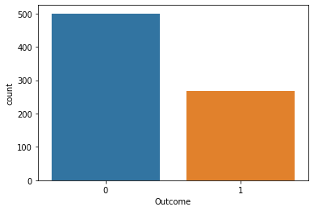
Dataset Description
SL NO | ATTRIBUTE | DESCRIPTION
1 | Pregnancy | Number of times pregnant
2 | Glucose | Plasma glucose concentration in an oral glucose tolerance test
3 | Blood Pressure | Diastolic blood pressure (mm Hg)
4 | Skin thickness | Triceps skinfold thickness (mm)
5 | Insulin | Two hour serum insulin
6 | BMI(Body Mass Index) | (BMI) is a measure of body fat based on height and weight that applies to adult men and women.
7 | Diabetes Pedigree Function | Diabetes pedigree function is a function which scores likelihood of diabetes based on family history
8 | Age | Age in years
Dataset Description:-
Figure 1: Ratio of Diabetic and Non Diabetic Patient
The 9th attribute is class variable of each data points. This class variable shows the outcome 0 and 1 for diabetics which indicates positive or negative for diabetics.
Distribution of Diabetic patient- We made a model to predict diabetes however the dataset was slightly imbal- anced having around 500 classes labeled as 0 means nega- tive means no diabetes and 268 labeled as 1 means positive means diabetic.

Slide 4
Data Preprocessing:-
Data pre-processing is most im- portant process. Mostly healthcare related data contains missing values and other impurities that can cause effective- ness of data. To improve quality and effectiveness obtained after mining process, Data preprocessing is done. To use Machine Learning Techniques on the dataset effectively ths process is essential for accurate result and successful prediction. For our diabetes dataset to perform pre -processing i have used two steps.
Missing Values removal-
Remove all the instances that have zero (0) as worth. Having zero as worth is not possible. Therefore this instance is eliminated. Through elimi- nating irrelevant features/instances we make feature subset and this process is called features subset selection, which reduces diamentonality of data and help to work faster.
Splitting of data-
After cleaning the data, data is nor- malized in training and testing the model. When data is spitted into (Train:Test) 70:30 then we train algorithm on the training data set and keep test data set aside. This training process will produce the training model based on logic and algorithms and val- ues of the feature in training data. Basically aim of normal- ization is to bring all the attributes under same scale.

Slide 5
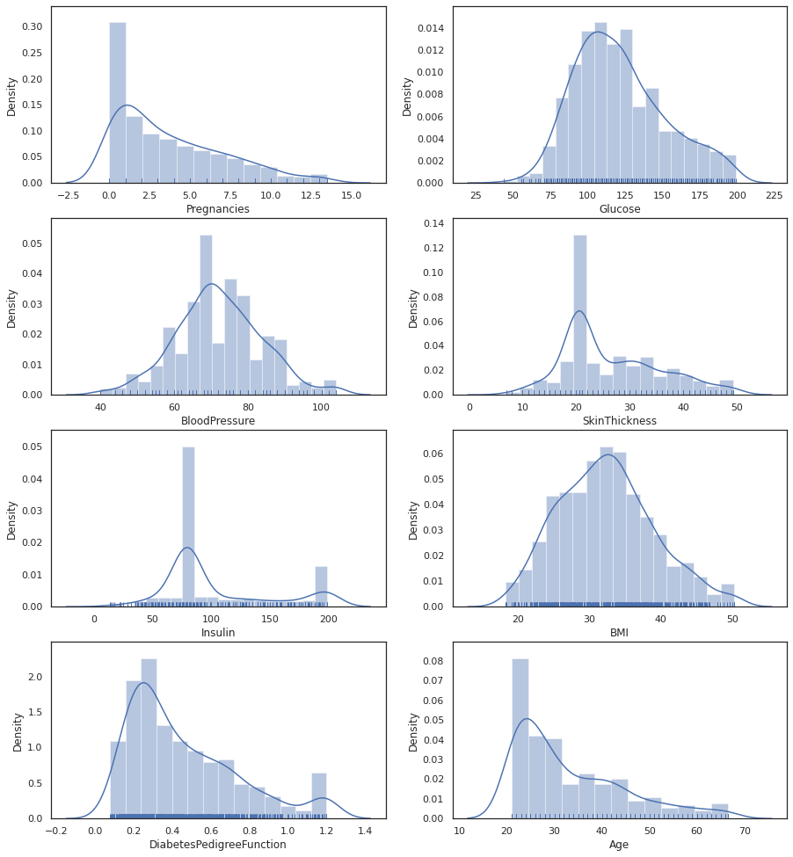
Data Visualization
Column names except for the target column are : Pregnancies, Glucose, BloodPressure,SkinThickness, Insulin, BMI, DiabetesPedigreeFunction, Age.
By plotting Distribution plot we can see that Glucose, Blood Pressure, BMI are normally distributed.Pregnancies, Insulin, Age, DiabetesPedigreeFunction are rightly skewed.

Slide 6
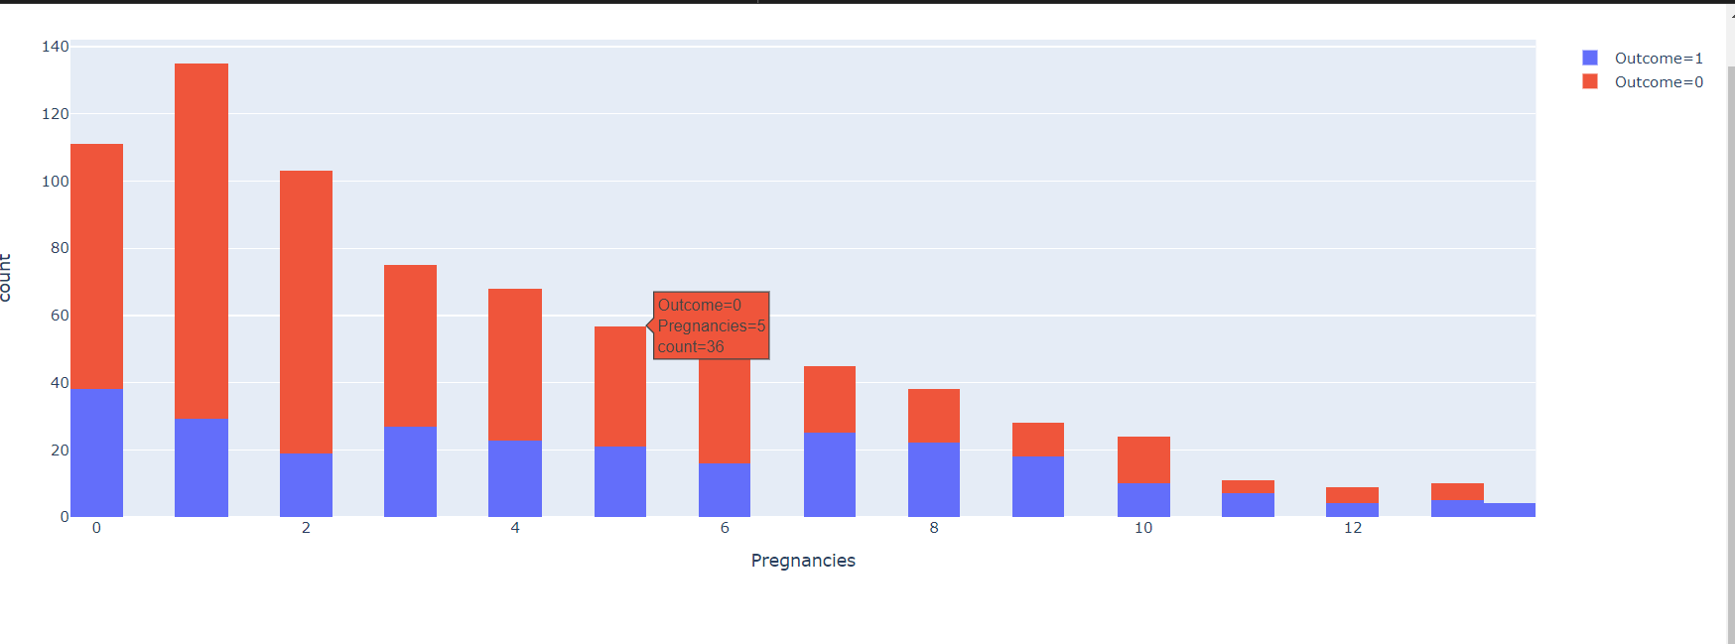
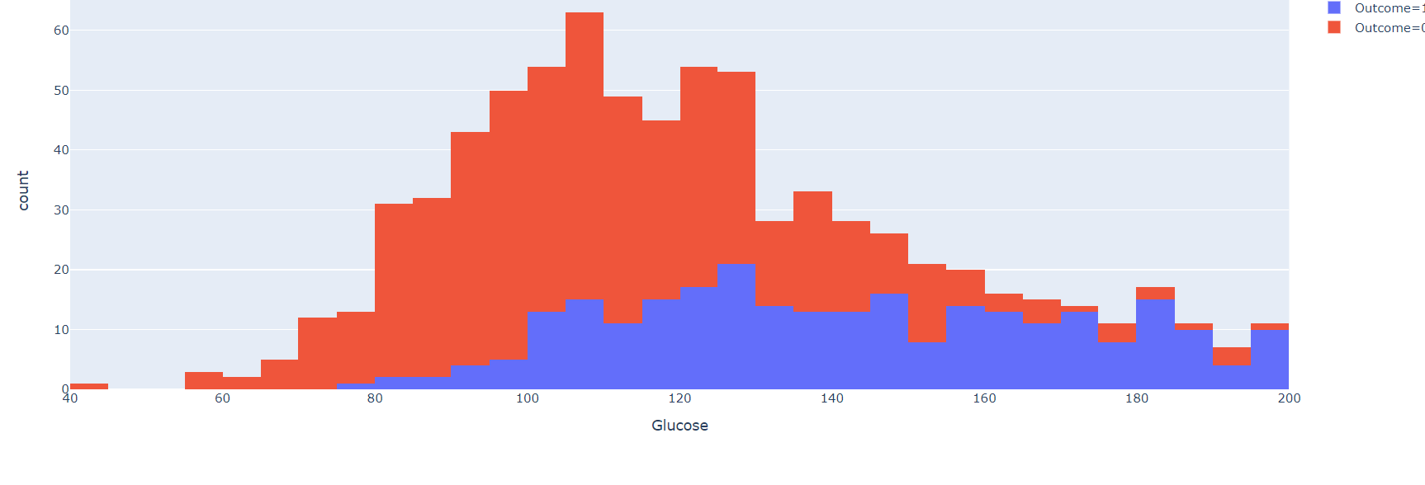
Pregnencies, Glucose Vs Outcome
Looking at the plot we can see that higher the number of pragnancies, more is the risks of diabetes
Higher Glucose level leads to more chances of Diabetes.
Pregnencies vs Outcome
Glucose vs Outcome

Slide 7
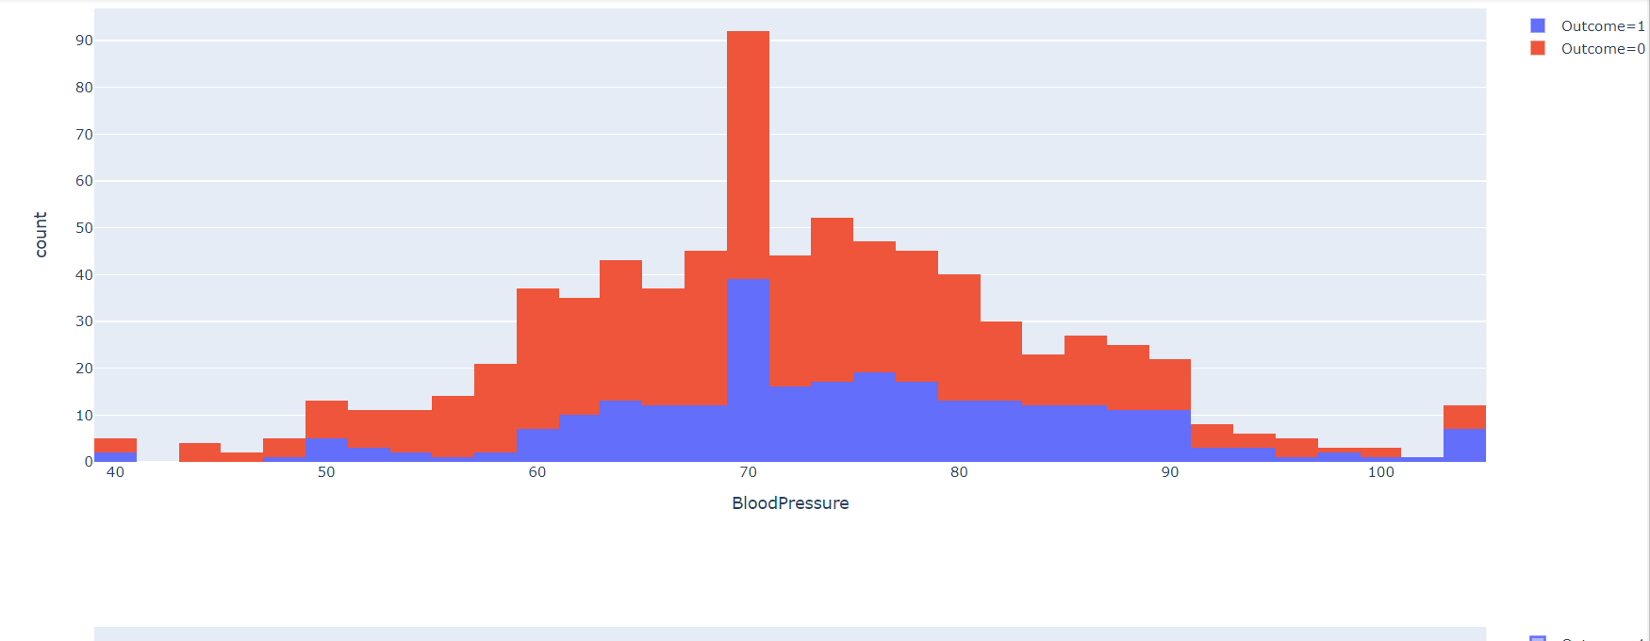
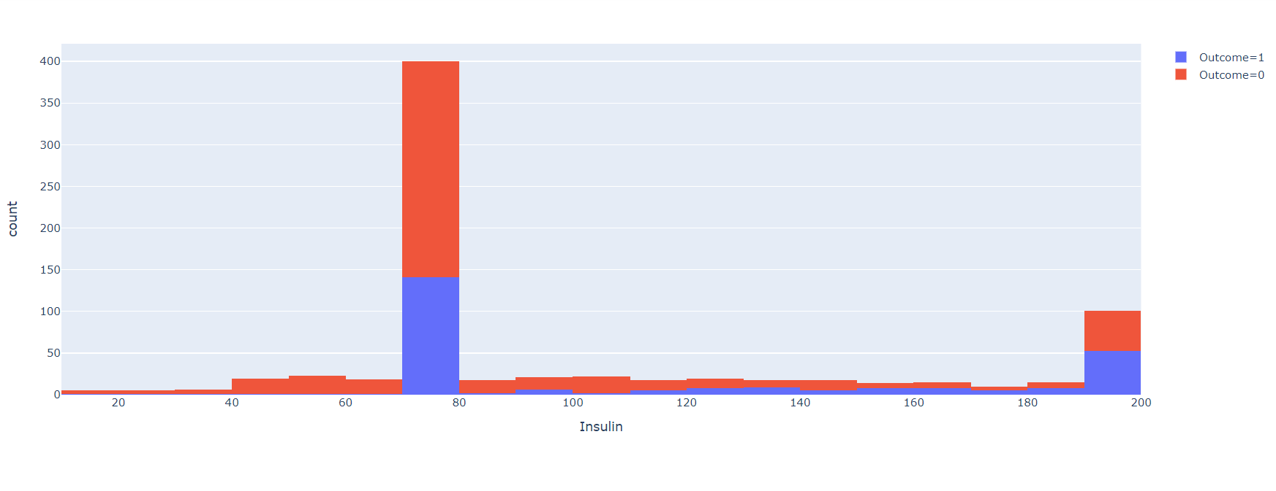
BloodPressure , Insulin Vs Outcome
we can seee that the probabilty of diabetes is higher when Blood pressure is high.
By seeing the graph we can say that higher the Insulin level more the chances of diabetes.

Slide 8
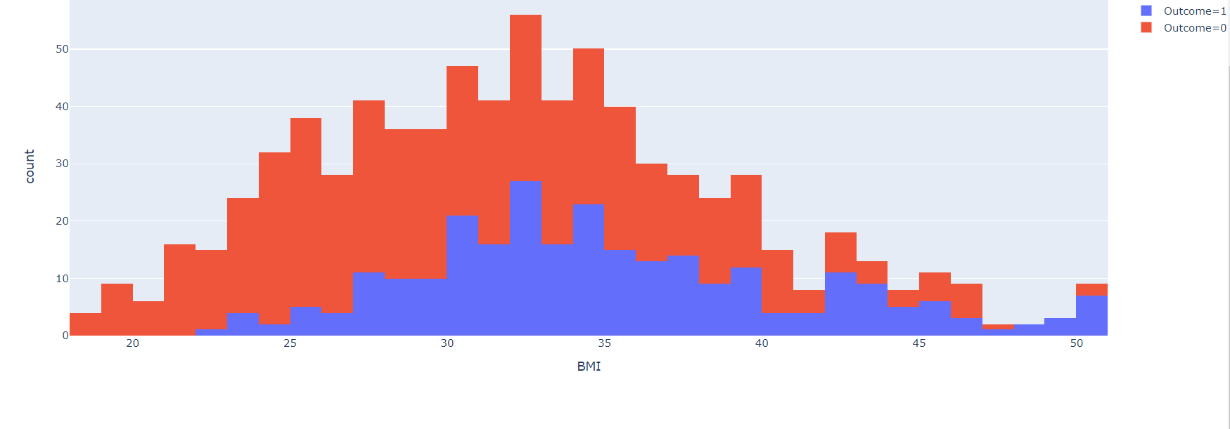
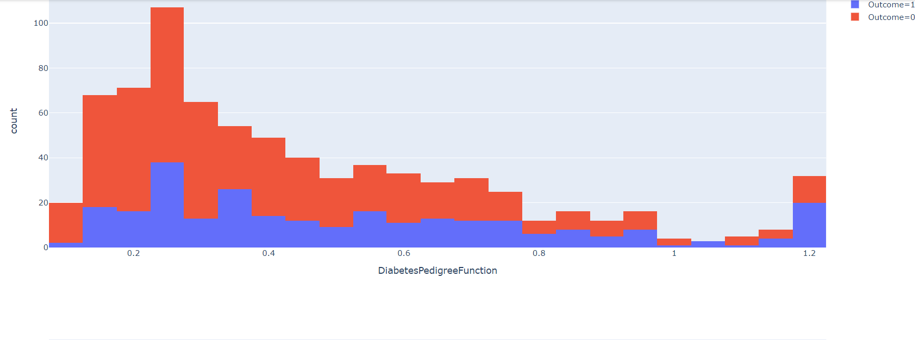
BMI ,Diabetes Pedigree Function Vs Outcome
We observe that higher the BMI more the chances of diabetes.
We observe that diabetic people have higher DiabetesPedigreeFunction value i,e genetic influence plays some role in the Diabetes among patients.

Slide 9
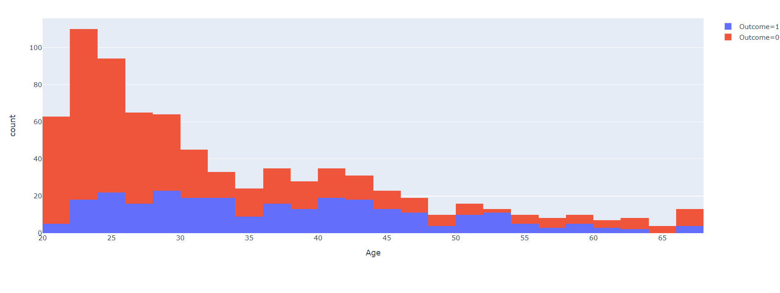
Age Vs Outcome
we observe that there is less chance of diabetes among young people and more chances for the people above the Age of years

Slide 10
Applying Machine Learning-
When data has been ready we apply Machine Learning Technique. We use different classification and ensemble techniques, to predict diabetes.Main objective to apply Machine Learning Techniques to analyze the performance of these methods and find accuracy of them, and also been able to figure out the important feature which play a major role in prediction.The Techniques are as follows-
1)Support Vector Classifier
2)K Nearest Neighbour Classifiers(KNN)
3)Decision Tree Classifier
4)Random Forest Classifier
5)Logistic Regression
6)Gradient Boosting.

Slide 11
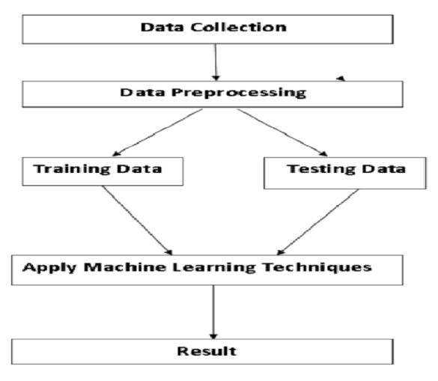
MODEL BUILDING
This is most important phase which includes model build- ing for prediction of diabetes. In this we have implemented various machine learning algorithms which are discussed earlier for diabetes prediction.
Procedure of Proposed Methodology-
Step1: Import required libraries, Import diabetes dataset.
Step2: Pre-process data to remove missing data.
Step3: Perform percentage split of 70% to divide dataset as Training set and 30% to Test set.
Step4: Select the machine learning algorithm i.e. K- Nearest Neighbor, Support Vector Classifier, Decision Tree, Logistic regression, Random Forest and Gradient boosting algorithm.
Step5: Build the classifier model for the mentioned ma- chine learning algorithm based on training set.
Step6: Test the Classifier model for the mentioned ma- chine learning algorithm based on test set.
Step7: Perform Comparison Evaluation of the experi- mental performance results obtained for each classifier.
Step8: After analyzing based on various measures con- clude the best performing algorithm.
Fig:- Overview of the Process

Slide 12
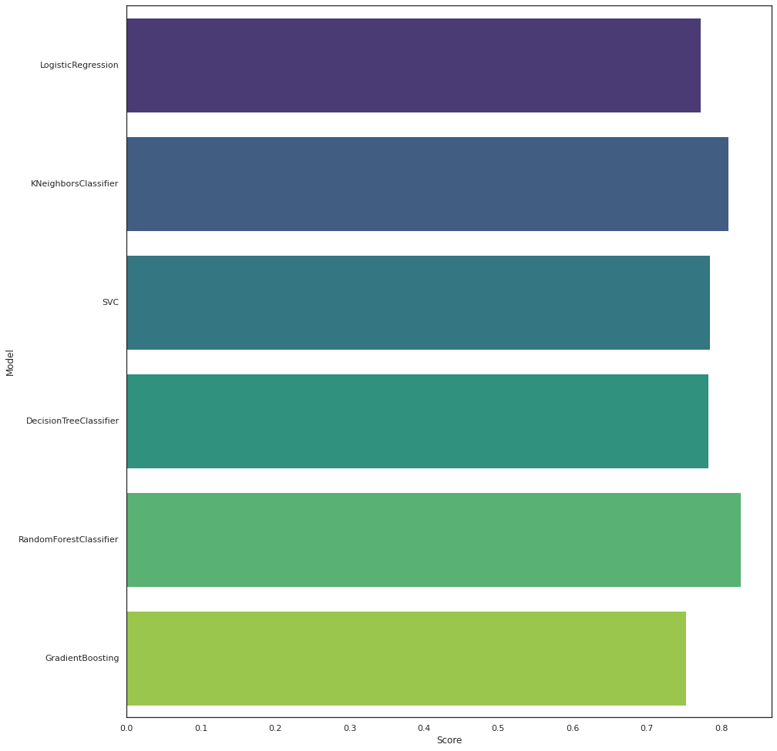
Accuracy Comparison
Model Score
1 RandomForestClassifier 0.826742
2 KNeighborsClassifier 0.809589
3 SVC 0.785149
4 DecisionTreeClassifier 0.782343
5 LogisticRegression 0.772251
6 GradientBoosting 0.753247
We can see that RandomForest classifier is the Best performing model with a score of 0.8239.

Slide 13
Result:-
In this work different steps were taken. The proposed approach uses different classification and ensemble methods and implemented using python. These methods are standard Machine Learning methods used to obtain the best accuracy from data. In this work we see that random forest classifier achieves better compared to others. Overall we have used best Machine Learning techniques for prediction and to achieve high performance accuracy. Figure shows the result of these Machine Learning methods.
Summary:-
Machine learning has the great ability to revolutionize the diabetes risk prediction with the help of advanced computational methods and availability of large amount of epidemiological and genetic diabetes risk dataset. Detection of diabetes in its early stages is the key for treatment. This work has described a machine learning approach to predicting diabetes levels. The technique may also help researchers to develop an accurate and effective tool that will reach at the table of clinicians to help them make better decision about the disease status.

Slide 14


